Slide 1


Declarative Privacy Policy: Finite Models and Attribute-Based Encryption
Peifung E. Lam, John C. Mitchell, Andre Scedrov,
Sharada Sundaram, and Frank Wang
Notes:
I will talk about some of the privacy issues faced by the healthcare industry, and how we attempt to help address these challenges using logic and encryption.
Using a section of Health Insurance Portability and Accountability Act (HIPAA) as an example privacy policy that satisfies certain acyclic condition, I will briefly discuss the following:
1. Our representation of complex privacy policies using a logic language to facilitate automatic compliance;
2. An algorithm to generate a finite, exemplary hospital that captures how the privacy policy applies to all possible hospitals, to support education, policy development, and policy debugging tools, and
3. Translation of the policy into an access policy used in Attribute-Based Encryption to protect electronic medical records.
I will start the talk with a short recorded demo of a prototype Health Information Exchange (HIE) that hopefully ties the concepts together.
This is joint work with John C. Mitchell, Andre Scedrov, Sharada Sundaram, and Frank Wang. We thank Ellick Chan for his help in improving the HIE prototype implementation, Nipun
Dave, Divye Khilnani and Vivian Shen for their help in the initial coding.

Slide 2
Background
Medical privacy problem
One part of a larger set of interesting challenges
Contextual integrity
Philosophical account of privacy, made precise
HIPAA formalization
Sample effort to write down complex policy and use this in prototype system
Notes:
PRIVACY AS CONTEXTUAL INTEGRITY
Helen Nissenbaum, etc.

Slide 3





Privacy in Organizational Processes
Patient medical bills
Patient
information
Hospital
Insurance Company
Drug Company
Advertising
Patient
GOAL: Respect privacy expectations in the transfer and use of personal information within and across organizational boundaries
Notes:
In our model,
agents that send and receive tagged personal information
are assigned organizational roles and responsibilities.

Slide 4
Healthcare Privacy Problem
HIE
Data needed for treatment
Electronic records and health information exchange can improve care, reduce costs
Most patients seen in emergency room were treated in an unaffiliated hospital in last six months
Patient access is important
Required by law
Diabetics can enter glucose data, improve treatment
Personal health devices: Blood pressure, Zeo, Fitbit, Withings
Doctor
Electronic Record
Insurance
Patient Portal
Quality care
HIPAA compliance
Patient privacy
Patient
Drug Co.
Privacy requirements
HIPAA law mandates privacy
Hospitals add policy
Insurer needs data for billing, should not deny coverage based on correlated factors
Notes:
EHR systems hold great promise in empowering patients and helping hospitals deliver healthcare more effectively.
Security and privacy of the EHRs are important issues, and they are regulated by federal laws such as HIPAA and other State and local laws and policies.
Health Insurance Portability and Accountability Act (HIPAA)
HIPAA Administrative Simplification, Regulation Text: 45 CFR Parts 160, 162, and 164 regulate the use and disclosure of personal health information.
The main focus is section 164 of HIPAA, which regulates the security and privacy issues in the health care industry.
Recent patient leak from Stanford Hospital, SAIC.
Auditing is an important function for checking HIPAA compliance.
Billing is another good reason to access EHR.
QR code can allow a patient to pick up prescription from more than one pharmacy.
Quantified Self.
-- How about in cancer genomics, jackson? Jobs?

Slide 5
Goals
Express policy precisely
Institute privacy policies
Privacy provisions from legislation
Analyze, enforce privacy policies
Does action comply with policy?
Does policy enforce the law?
Education
Increase stakeholders’ understanding of complex policies
reduce variation in how policies are applied by employees

Slide 6

Contextual Integrity
Philosophical account of privacy
Transfer of personal information
Describes what people care about
Flow governed by norms
Agents act in roles in social contexts
Information categorized by type
E.g., personal health information, psychiatric records, …
Rejects public/private dichotomy
Principles of transmission
Confidentiality, reciprocity, etc
[Nissenbaum 2004, BarthDMN ‘06]

Slide 7
Privacy Model: “Contextual Integrity”
Charlie’s SSN
078-05-1120
Alice
Bob
Four identifiers of an action:
Sender
Receiver
Person this is about (subject)
Type of information

Slide 8
What is the logical structure of HIPAA?
Sections of HIPAA can permit and prohibit actions
Allow action if
There is a clause that explicitly permits it
No clause explicitly forbids it
164.502 (a) Standard:
(1) Permitted uses and disclosures.
(ii) For treatment, payment, or health care operations,
as permitted by and in compliance with 164.506;

Slide 9
More details
Action: ⟨to, from, about, type, purpose, consents, beliefs⟩
Translate each HIPAA clause into
Set of allow clauses
Allow(action) :- ...
Set of deny clauses
Deny(action) :- ...
Combine clauses according to Contextual Integrity model
Permit action if
Prolog program can derive reason to Allow the action
Prolog program cannot derive reason to Deny the action

Slide 10




MyHealth@Vanderbilt Workflow example
Humans + Electronic system
Health Answer
Appointment Request
Secretary
Health Question
Health Question
Doctor
Patient
Health Question
Health Answer
Utility: Schedule appointments, obtain health answers
Nurse
Privacy: HIPAA compliance+
Notes:
Secure free text messaging system

Slide 11
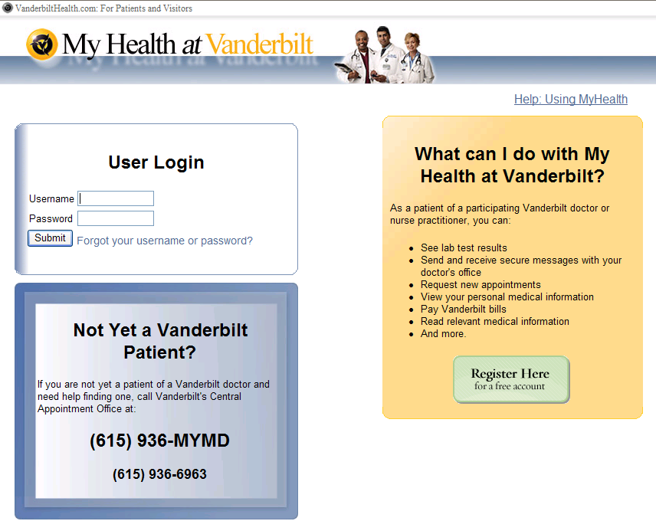

Slide 12
Notes:
Research Prototype

Slide 13
Notes:
Research Prototype

Slide 14
Finite Model for Privacy Laws
Motivation: Construct a finite illustrative organization that exhibits all the cases of interest w.r.t. the privacy policy
Applications
Education and training
Policy development
Compliance debugging tools
Q: Does such a finite illustrative organization exist?
A: Under an acyclicity assumption, the answer is yes, and an algorithm is presented to generate such a finite model.
Notes:
for a given policy, if there is a fixed finite set of individuals, with specific roles and relationships, that exhibit all the cases of interest in all applicable hospitals (or other such organizations).

Slide 15
Background on Logic Programming
Fact: p(x)
Rule: r(X₀) <− q₁(X₁), …, q_{n}(X_{n})
Extensional and intensional database
Stratified program
Inference from a stratified program
Dependency graph
Notes:
for a given policy, if there is a fixed finite set of individuals, with specific roles and relationships, that exhibit all the cases of interest in all applicable hospitals (or other such organizations).

Slide 16
Setup of a finite model for privacy policy
A Hospital is a finite structure (Domain, Rules, Facts)
Action: an action of communication is a tuple (u_{s}, u_{r}, u_{o}, m_{t}, m_{p}, c, b)
Acyclicity assumption: the dependency graph of the Prolog program constructed from the formalization of a privacy policy is acyclic.
Notes:
for a given policy, if there is a fixed finite set of individuals, with specific roles and relationships, that exhibit all the cases of interest in all applicable hospitals (or other such organizations).

Slide 17
Algorithm to Generate Exemplary Cases for an Acyclic Privacy Law
Construct the compliance tree for the acyclic law
Normalize it (push NOT operators to the bottom)
Using De Morgan’s Laws and Boolean algebra
Construct the search trees
For each search tree, add an exemplary case instance to the model that satisfies all the nodes in the tree

Slide 18
Compliance Tree of an Acyclic Law
Notes:
A compliance tree determines when an action complies with the acyclic law.

Slide 19
Normalized Compliance Tree
Notes:
A compliance tree determines when an action complies with the acyclic law.

Slide 20
A Search Tree
Notes:
A compliance tree determines when an action complies with the acyclic law.

Slide 21
Main results regarding the construction
The model for an acyclic law constructed using the algorithm is finite
Every action a permitted by the law satisfies some search tree T_{S} of a valid proof tree T_{P} = (T_{S} , θ_{S}), where T_{P} and T_{S} are associated with the Representative Hospital H = (Domain, P, D_{EDB}). And each valid proof tree T_{P} = (T_{S} , θ_{S}) produces an action θ_{S}(A) that is permitted by the law within the Hospital H, where A is a variable vector of the action type.

Slide 22
Secure Health Information Exchange
Given a general declarative privacy policy, can we use it for purposes besides compliance and audit?
How do you enforce some form of access control after the data have left your organization?
Approach taken: transform a policy formalized as a logic program into an access control policy used in Ciphertext-Policy Attribute-Based Encryption (CP-ABE).

Slide 23
Encrypted medical data in the cloud
Hospital
Policy Engine
Applications:
HIE, Affiliated clinics
Medical research
Query
Encrypted Medical Data
Attribute-based Encryption
Database
User
Attribute-based Decryption
Credentials
EHR
Notes:
With HIE and HIN(health info networks), the records are going to the cloud.
How do we keep the data safe, given that we don’t have complete trust in the cloud storage?
Our approach uses ABE to simplify the enforcement of access control policies.
Using our approach, hospitals can protect EHRs by encrypting them based on a policy generated by our module, so that only the people authorized to access the EHR under HIPAA will be able to decrypt the file.
---
HIE: only the authorized people in the other organization could decrypt it.
Challenges in the cloud, how to keep the records safe.

Slide 24





Attribute-Based Encryption
ϕ =
OR
PK
AND
Doctor
OR
Nurse
ICU
Doctor
AND
✓
✗
Nurse
ICU
SK
SK
“Doctor”
“Neurology”
“Nurse”
“Physical Therapy”
Notes:
Here is an example of ABE policy. The policy says that only a person who is either a doctor or a nurse working at ICU is allowed to decrypt the EHR.
-------
Access control is built into the ciphertext.
SK: secret key
PK: public key
Our scheme provides a simple way to provide privacy.
Provide the protection by encrypting it. Decrypt to access.
We enforce the policy by using ABE. Here is how it works.
Use Access instead of decrypt

Slide 25
Background on CP-ABE
Ciphertext-Policy Attribute-Based Encryption operations
Setup(U)
Encrypt(PK, (M, ρ), M)
KeyGen(MSK, S)
Decrypt(CT, SK)
Notes:
Here is how we generate the access policy for ABE.
Given an EHR we want to export, we run a datalog query to determine the access policy, and transform it into the access control policy for ABE.
-----
Take the policy and access rights derived from HIPAA (and local hospital policy), encode them into the ABE policy.
Generate ABE policy from HIPAA policy Projection.
Representation of action by a tuple.
From among the actions that are compliant with the law, select the rows that match the given search criteria.
Project the remaining attributes to obtain the set of recipients allowed access to the HER, along with the conditions under which they are allowed access.
Export EHR. 3-4 sentences per slide.

Slide 26
Extracting ABE data policy
HIPAA, Hospital policy
Policy: Action {allow, deny}
Action characterized by
⟨ from, about, type, consents, to, purpose, beliefs ⟩
Data policy
SELECT rows with given attributes: from, about, type, consents
PROJECT them to generate the associated ABE access policy
{⟨to, purpose, beliefs⟩ |
Policy (⟨ from, about, type, consents, to, purpose, beliefs ⟩) = Allow}
Notes:
Here is how we generate the access policy for ABE.
Given an EHR we want to export, we run a datalog query to determine the access policy, and transform it into the access control policy for ABE.
-----
Take the policy and access rights derived from HIPAA (and local hospital policy), encode them into the ABE policy.
Generate ABE policy from HIPAA policy Projection.
Representation of action by a tuple.
From among the actions that are compliant with the law, select the rows that match the given search criteria.
Project the remaining attributes to obtain the set of recipients allowed access to the HER, along with the conditions under which they are allowed access.
Export EHR. 3-4 sentences per slide.

Slide 27
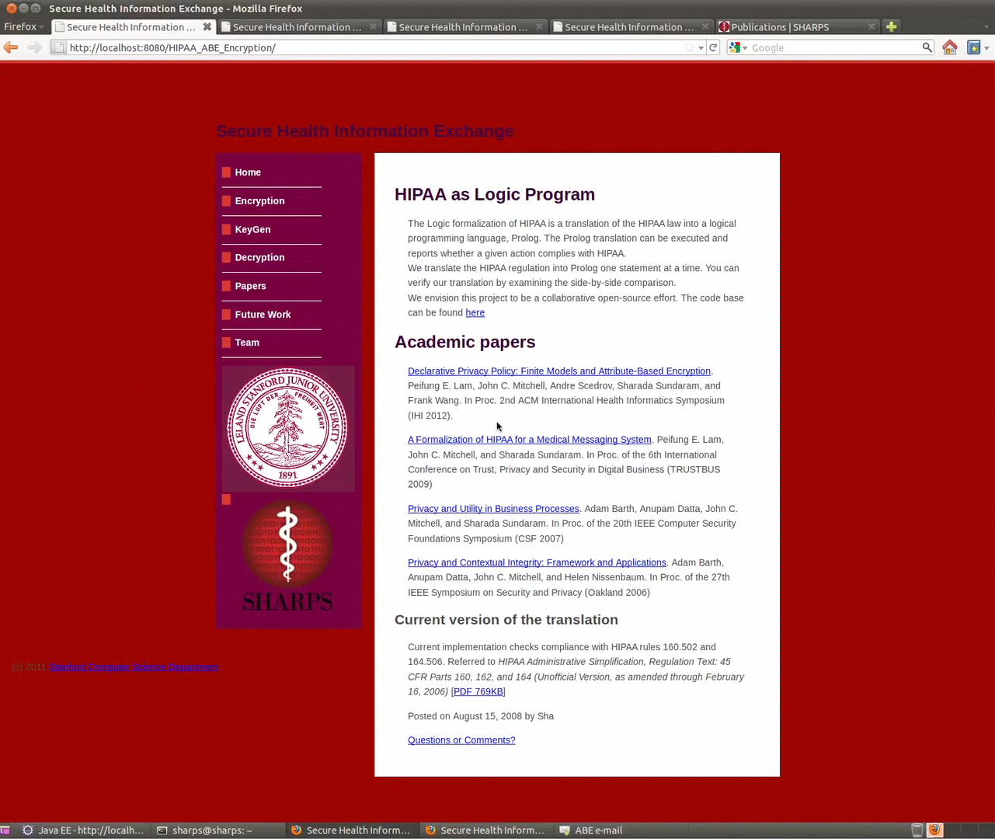
Play Prototype Demo Video
Notes:
Prototype. Source code is available on Github. See references.

Slide 28
Prototype
Notes:
Prototype. Source code is available on Github. See references.

Slide 29
Performance
Time (ms)
OR Clauses
Notes:
Fixed cost, disk access, thread creation cost, etc. So doubling number of threads doesn’t reduce the time by half.
For encryption, little knowledge about the receiver, so need to process all variations.
For decryption, possible precomputation / short cuts to determine which policy rule will apply.

Slide 30
Open Issue
No direct support of Parameterized Roles in ABE
Format: R(p₁, p₂, …, p_{n})
E.g.,164.502 (g)(3)(ii)A … a covered entity may disclose, or provide access in accordance with §164.524 to, protected health information about an unemancipated minor to a parent, guardian, or other person acting in loco parentis;
Workaround
Hardcode parameter values into the attribute name, e.g. inLocoParentis_Joe
Challenges
Identity silos across organizations
Notes:
We encountered some issue related to the encoding of parameterized roles in ABE. I will happy to talk about this more offline, if you are interested.
Efforts by ONC / DIRECT to use Oauth.
In emergencies, user authorization (e.g. the Oauth model) may not be applicable.
----
Not any one’s in loco parentis, but the patient’s in loco parentis.
As a simple example, suppose Tom is a teenager patient. Under HIPAA his parents will be allowed access to his PHI. However, not every person with the attribute ‘parent’ should be able to access Tom’s PHI.
One could imagine hospital policies restricting access to PHI to patient’s primary care physicians.
If someone is a parent, not sufficient, wants to know whose parent
Identity silos: the same person may be issued different identities by different organizations. So, for example, Tom’s father may need to have multiple parameterized roles (inLocoParentis_TomId1, inLocoParentis_TomId2, etc.) based on how Toms is represented in a given organization.

Slide 31
References
Declarative privacy policy: Finite models and attribute-based encryption, P.E.Lam, J.C.Mitchell, A.Scedrov, et al., IHI 2012.
Scalable Parametric Verification of Secure Systems: How to Verify Reference Monitors without Worrying about Data Structure Size, J. Franklin, S. Chaki, A. Datta, A. Seshadri, Proceedings of 31st IEEE Symposium on Security and Privacy, May 2010.
A Formalization of HIPAA for a Medical Messaging System
P.F. Lam, J.C. Mitchell, and S. Sundaram, TrustBus 2009.
Privacy and Contextual Integrity: Framework and Applications,
A. Barth, A. Datta, J. C. Mitchell, and H. Nissenbaum, Proceedings of 27th IEEE Symposium on Security and Privacy, May 2006.
Healthcare privacy project source code
http://github.com/healthcareprivacy
Demo (under construction)
http://crypto.stanford.edu/privacy/HIPAA/

